Slide 1
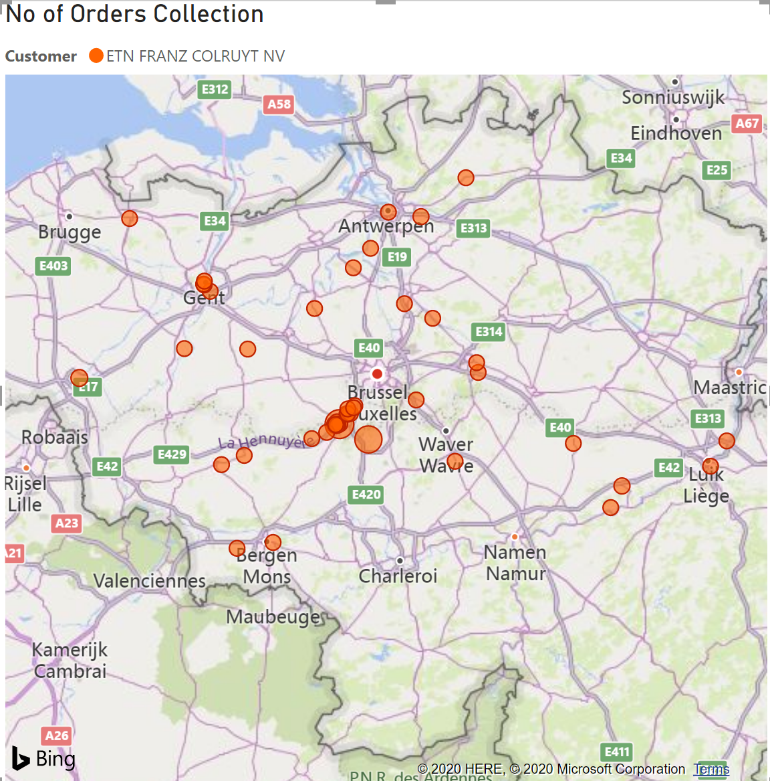
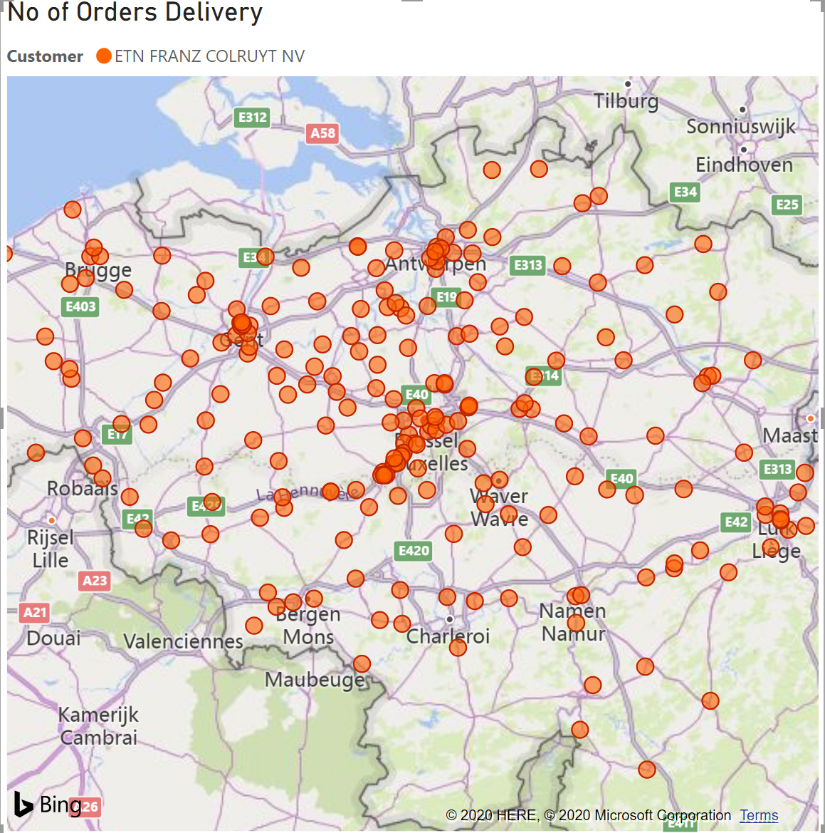
TMS Orders Dashboard
Customers
Orders Geographically
Count of Orders by YearMonth

